Slide 1
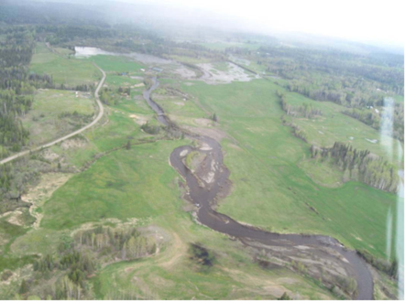
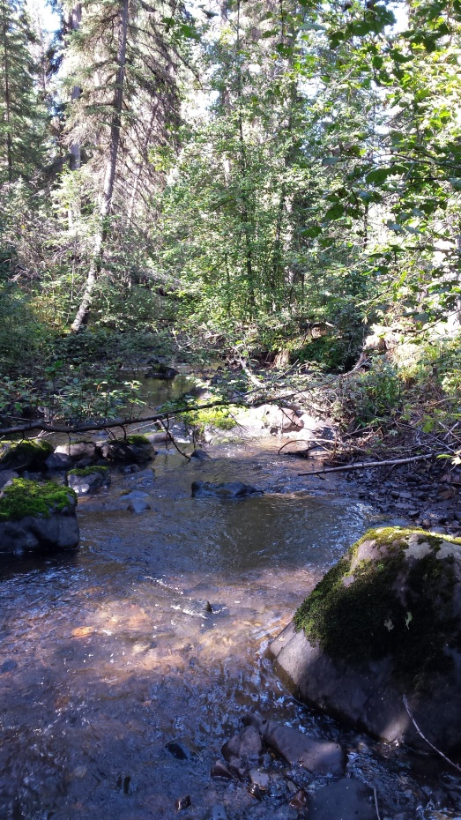
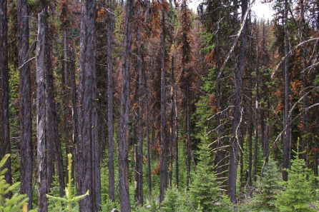
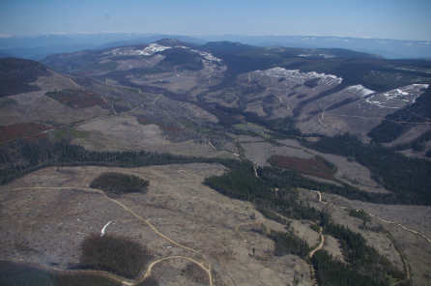
Opportunities for Directing Change on the Forested Landscape
Doug Lewis, RPF
SISCO Winter Workshop
February, 2016

Slide 2
“Study the Past if You Would
Define the Future”
Confucius
Notes:
John K asked me to speak as a “young” forest professional and comment on our work as positive force for change – not that young
I wanted to reflect on 20 year career starting out as forestry student – masters degree – research on lichen, mountain caribou
Work in government over the last 10 years, dealing with large-scale change on the landscape associated with MPB salvage , and last few years working on developing a framework for assessing and managing cumulative effects Cumulative effects assesment involves understanding the combined effects of past, present and future human activities and natural disturbances on things we value
To date, our work has focused largely on the past and present, with hopes of looking to the future
I am very interested in the history part – it is very important

Slide 3
History Repeats Itself….
Notes:
Why is Understanding History Important – well, it repeats itself

Slide 4
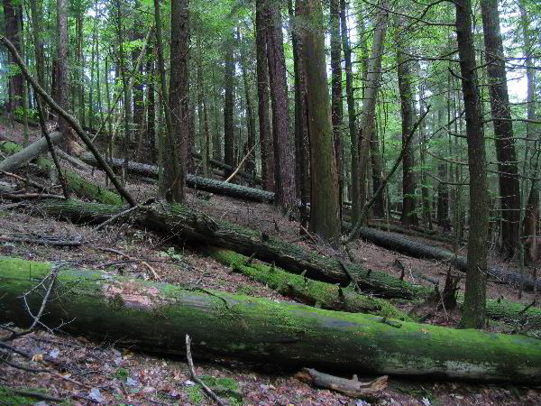
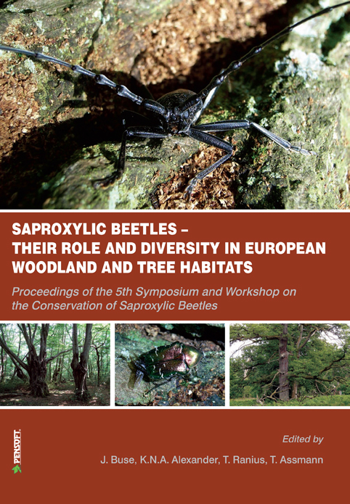
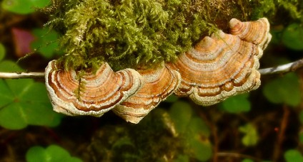
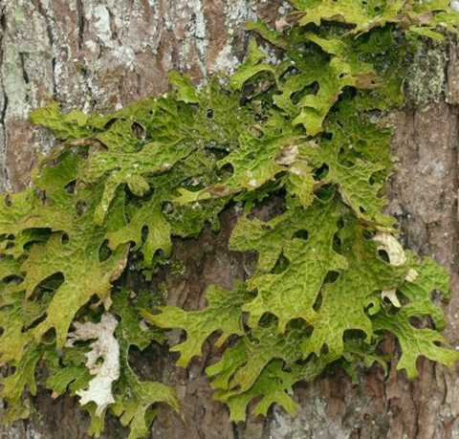
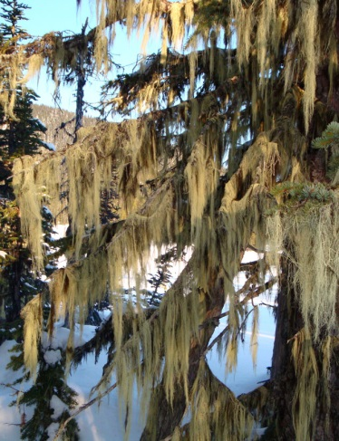
Sweden
Linder and Ostlund (1998) In Lindenmayer and Fischer (2006)
Notes:
Historic factors are often the cause of many current issues
For example;
Sweden, practicing industrial forestry at a large- scale for much longer than in BC, primarily small privately owned parcels of land
Industrial forestry reduced important structural attributes ( large trees, snags, large downed logs)

Slide 5
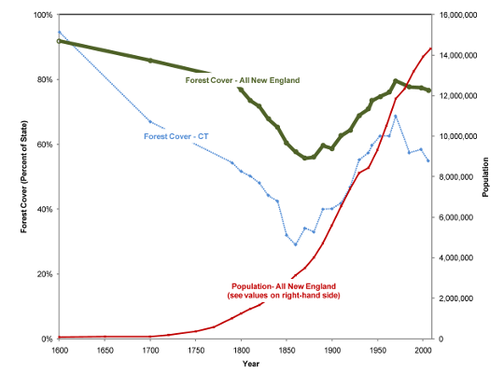
Northeastern United States
Notes:
Other factors may be resulting in unexpected changes
For example in the Northeast US, Increase in forested areas with abandonment of agricultural land as the population increases and becomes more urbanized.
This has led to the re-colonization of extirpated species such as American Marten that were lost over a century ago due to the combined effects of habitat loss and trapping.

Slide 6
Notes:
In BC, where large-scale industrial forestry is more recent, climate and natural disturbances have played a large in shaping our forests
Starting with the ‘hockey stick’ that shows changes in climate in the past 1000 years – want to focus on teh last 150 years in particular
Sets a context Understand the role of Climate in shaping the forests we have today

Slide 7
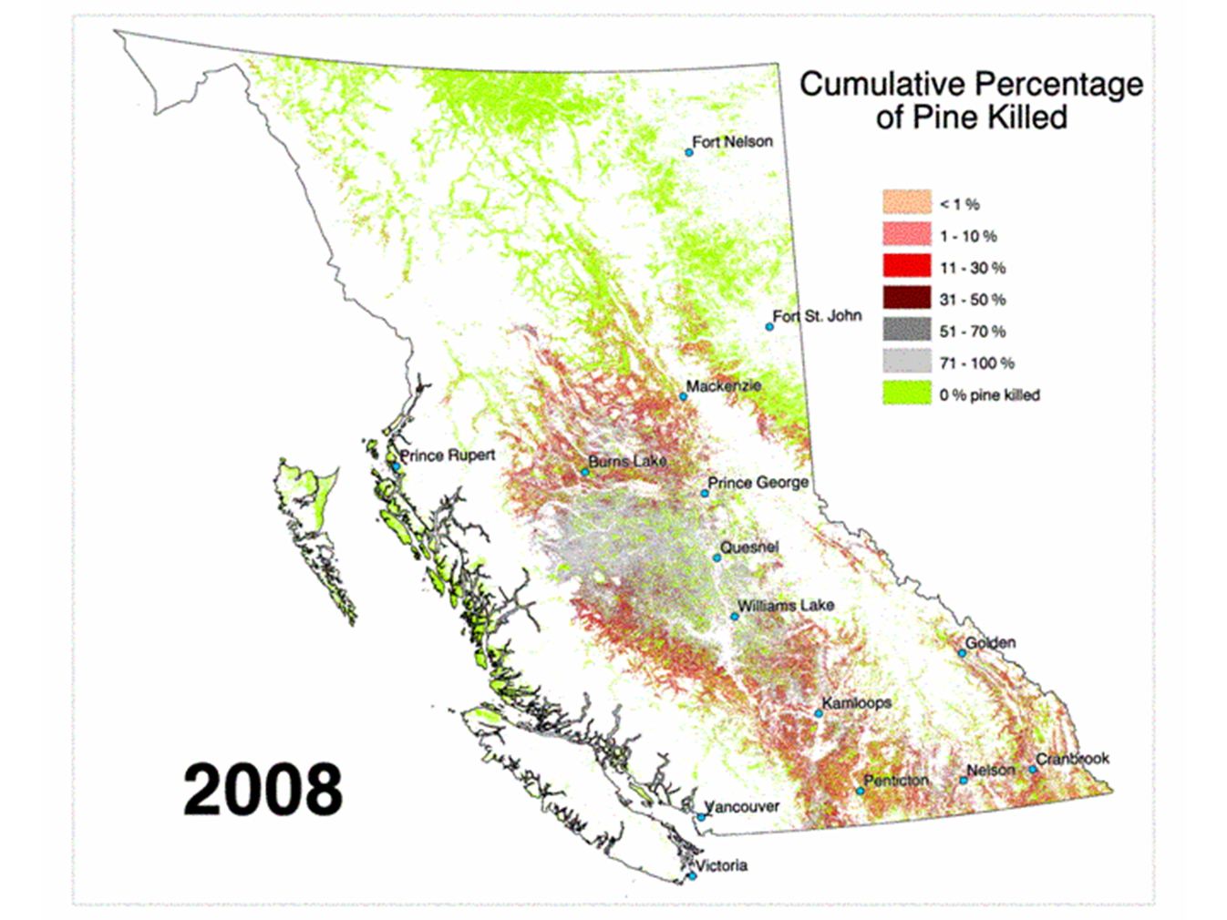
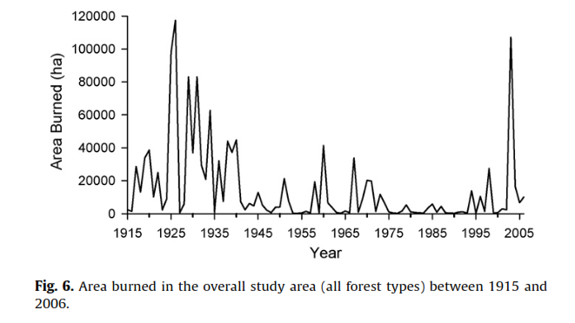
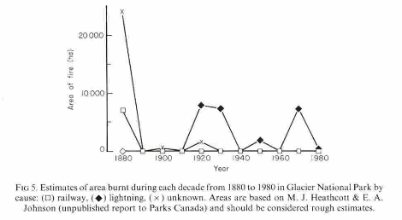
Dry Douglas Fir and Ponderosa Pine forests near Kamloops, BC
(Klenner et al. 2008)
Taylor and Carroll ( 2004)
Glacier National Park
(Johnson et al. 1990)
Notes:
Various means have been used to reconstruct the disturbance history associated with climate that has shaped the forest of today.
Spikes in areas burned in dry forests around Kamloops over the past 100 years associated with trends in climate
Similar trends in glacier national park – with increase disturbances associated with human activity
And in pine-dominated forests of BCs interior
Declining trend over the past century – combination of fire suppression, young stands
Precipitated in MPB outbreak of last 15 years (add MPB outbreak photo)

Slide 8
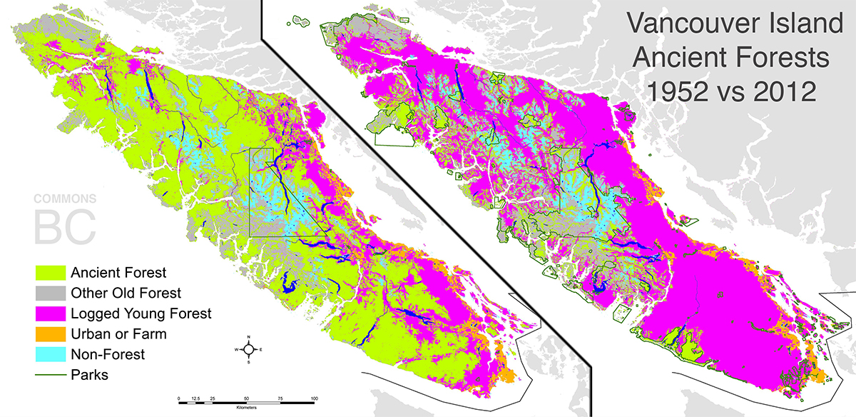
Source: Hagerman et al. 2010
Notes:
Land Use and Government Policy also play a large role in changing the forest in BC
Rapid increase in volume and area harvested in BC after world war 2 to the 1980’s – coast and wetter parts of the interior harvesting was most pronounced
Stabilized through the 1990’s with the implementation of land use plan, protected areas strategy, forest practices code and FRPA

Slide 9
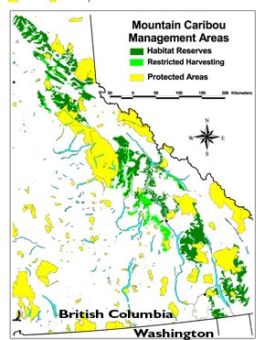
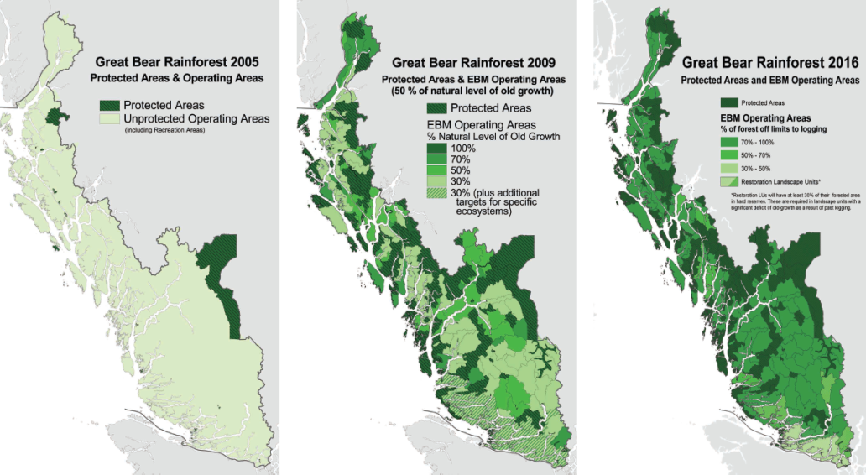
Parks and Protected Areas in BC, Since 1939
Notes:
Provincially the area protected increased
On the coast, area harvested declined – EBM strategies
Recovery strategies for species like Mountain caribou have reserved or restricted harvesting over large areas

Slide 10
Source: BC Ministry of Forests State of the Forest Report 2010
Notes:
What is the result in BC,
Based on this figure – using best available forest inventory data - suggests the area of young forest has actually declined over the past 50 or so years
Old forests – generally >250 years stayed the same,
But the area of the land in mature forest aged 80 to 160 years has increased as forests have regenerated and become older following historic disturbances disturbances.
However, this can be highly variable depending on where you

Slide 11
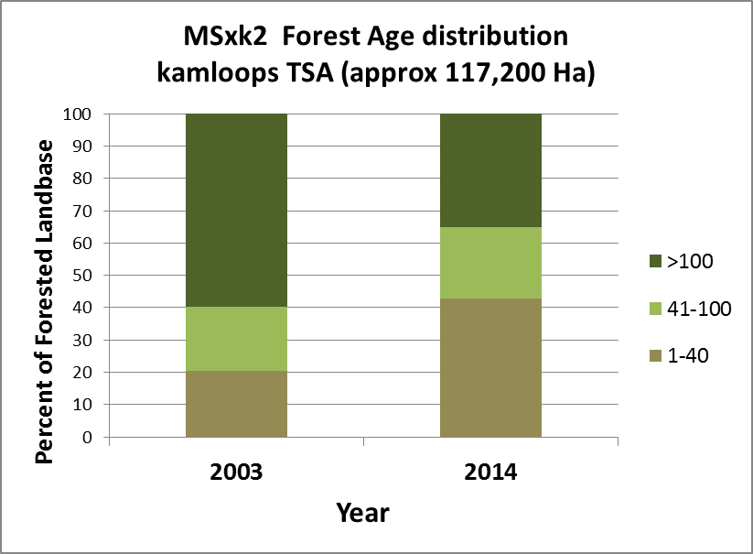
Kamloops Area
Global Forest Change Viewer, University of Maryland
2014
2013
2012
2000+
Water
No Change
Notes:
In this area around kamloops – we can see the combined effects of MPB and associated salvage over the past decade or so on the pine-dominated plateaus.
In some BGC subzones, this has reduced the area of mature and old forest from almost 60% to 35, increase area of early and mid-seral forest

Slide 12
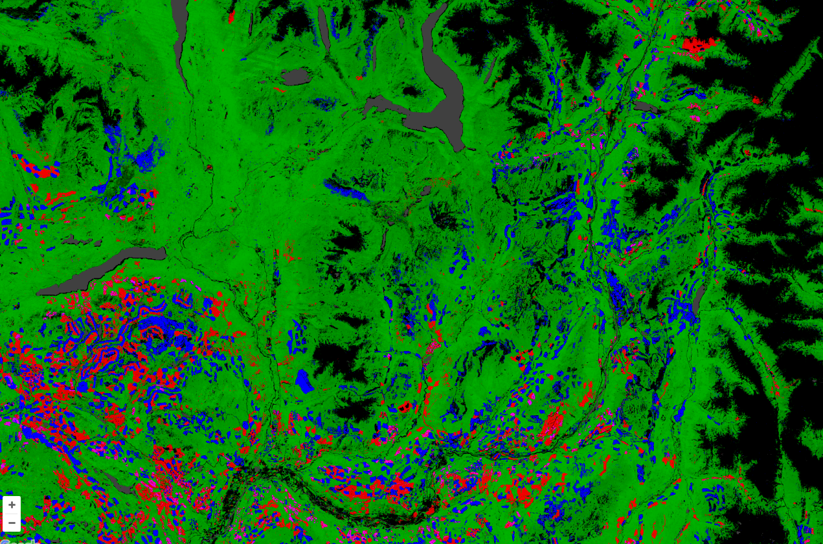
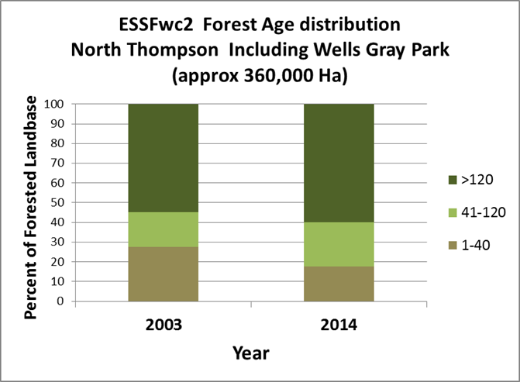
North Thompson- Wells Gray Park
Global Forest Change Viewer, University of Maryland
Murtle Lake
Blue River
Gain (2000-2012)
Clearwater
Loss (2000-2012)
Loss and gain
Forested area
Water
Non-Forest
Notes:
In the wet belt area North of Clearwater, bordering Wells gray park we can see a general gain in the forested area – with blue showing older cutblocks and fires regenerating. This is largely due to the shift in harvest away from this area due to MPB salvage in the south of the Kamloops TSA and the implementation of reserves and restricted harvesting with the Mountain Caribou recovery plan.
In the ESSF wc2 BGC subzone – within the Kamloops TSA – the area of early seral dropped area of mid-seral and older forests increased as older disturbances age, and in some cases

Slide 13
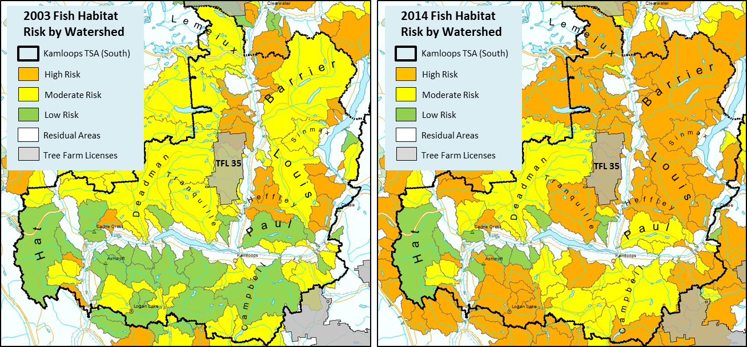
CEA Watershed Assessment Results: South Portion of Kamloops TSA
Effects:
MPB salvage
+
NRS Activity
+
Significant historic effects
(private land)
+
Location of forest clearing that interacts with Range use

Slide 14
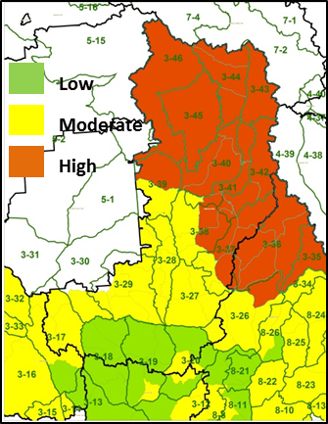
CEA Results – Moose-Kamloops TSA
Moose
Likelihood of Population Decline
Associated with:
Predation
Increased access – hunting
Loss of thermal cover habitats

Slide 15
CEA Results-Pine marten-Kamloops TSA
Pine Marten
Likelihood of Population Decline
Associated with:
Habitat protection in the north
Parks
Mountain caribou recovery
Habitat loss and fragmentation in middle and south of TSA
MPB Salvage harvest
Low
Moderate
High

Slide 16
Results of Cumulative Effects Assessments
Effects on values a result of combined influence of many factors
Impacts often unintended
Forest and other sectors generally compliant
Sometimes not achieving stated objectives for values
Suggests policy and/or regulator review
Clarify Objectives
Evaluate Effectiveness

Slide 17
Opportunities for Defining the Future
When asked;
“would you rather work for change or just complain?”
81% of the respondents replied:
“Do I have to choose? This is hard.”
Change is not easy.
Opportunities exist for ‘positive’ change
Discuss and choose what those changes should look like to help define the future.
Notes:
Actions put forward today and in the future will shape the forested landscapes for the next decades centuries

